Slide 1
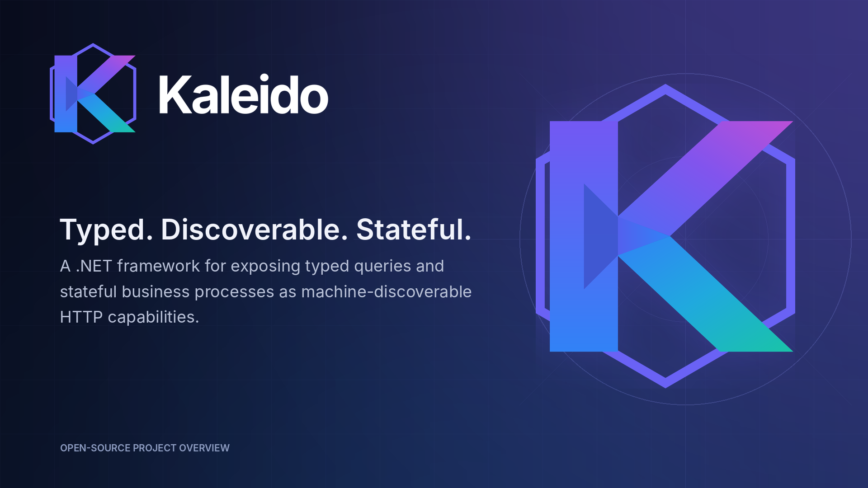
EXECUTIVE OVERVIEW
Workflows • channels • interoperability • governed AI
PRE-1.0 PROJECT PREVIEW

Slide 2
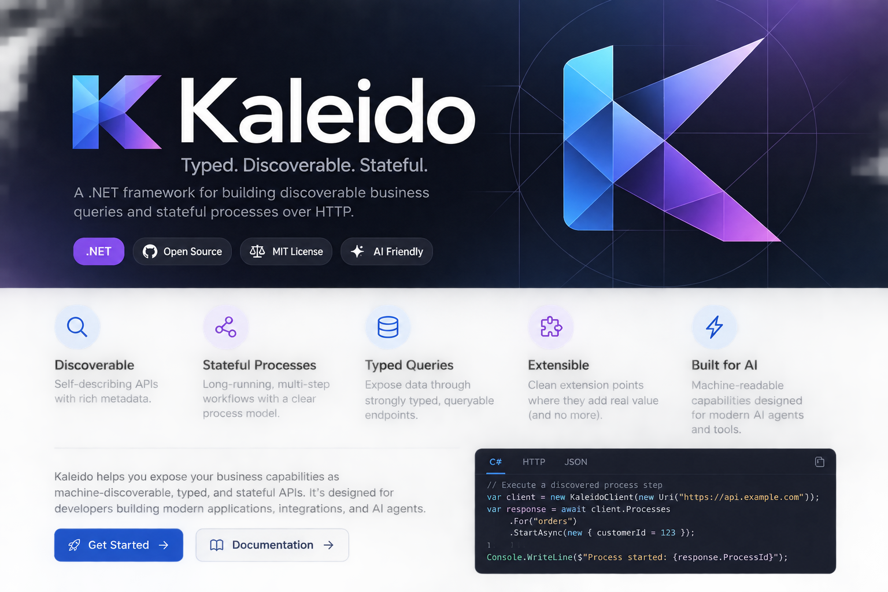


WHY LEADERSHIP SHOULD CARE
The integration tax grows with every new consumer
Without a shared capability contract, each workflow, channel, standard, and agent rebuilds the same business integration.
BEFORE KALEIDO
Each consumer builds its own path
Workflow / Pega
own adapter • mapping • rules
IVR / contact center
own adapter • mapping • rules
Web and mobile
own adapter • mapping • rules
Da Vinci / partners
own adapter • mapping • rules
AI agents
own adapter • mapping • rules
Repeated validation, state handling, errors, testing, and maintenance.
COST AND INCONSISTENCY COMPOUND
AFTER: ONE SHARED CAPABILITY CONTRACT
Business value: reduce duplicated integration while preserving the platforms already in place.

Slide 3
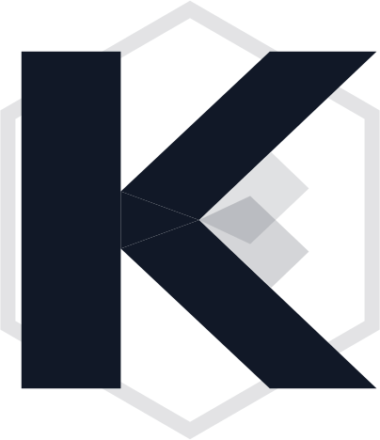
WHAT KALEIDO DOES
Three business building blocks make the model memorable
The executive language describes the outcome; the Kaleido term identifies the framework primitive.
QUERYABLE
PROCESS
REGISTRY
Business Information
Business Actions
Capability Catalog
What does the business know?
What can the business do?
How does a consumer find it?
Typed views and parameters
Stateful, multi-step actions
Capability names and metadata
Search, filter, sort, and page
Dependencies and availability rules
Advertised query and execution URLs
Published field and constraint metadata
Next-step guidance through process state
Local and downstream aggregation
CONSISTENT INFORMATION CONTRACTS
CONSISTENT ACTION CONTRACTS
CONSISTENT DISCOVERY
BUSINESS INFORMATION + BUSINESS ACTIONS + CAPABILITY CATALOG = A SHARED OPERATING MODEL
Kaleido — executive overview

Slide 4
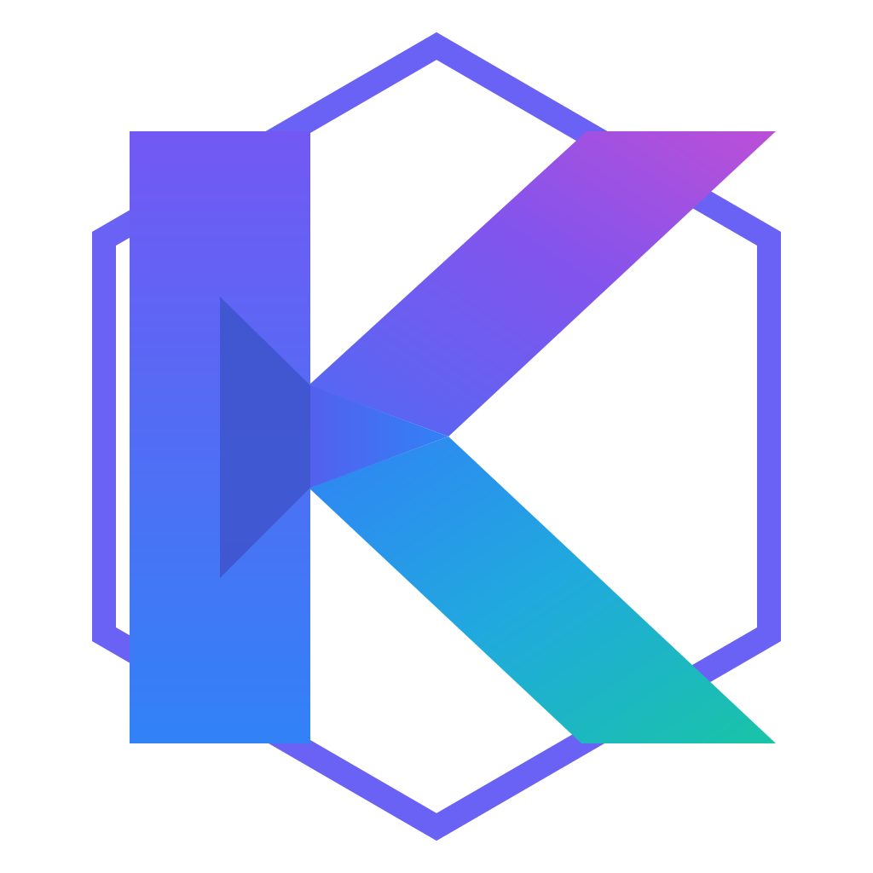
OPERATING MODEL
SHARED CAPABILITY CONTRACT
Build once. Reuse everywhere.
One capability model across every channel—without replacing workflow, channel, or interoperability platforms.
Workflow &
case tools
IVR / contact
center
Digital
channels
Standards &
partners
Governed AI
agents
KALEIDO
Shared business capability contract
BUSINESS INFORMATION
BUSINESS ACTIONS
CAPABILITY CATALOG
Queryable
Process
Registry
metadata • validation • typed clients • process identity • correlation • telemetry
Member
Provider
Rules
Orders
Prior Auth
Reference
Kaleido is the contract layer—not the workflow engine, channel runtime, or interoperability standard.
The platforms keep doing what they do best.
Kaleido — executive overview

Slide 5
CURRENT DIRECTION
INITIAL ADOPTION PATHS
Where Kaleido fits first
The immediate value is reuse across orchestration, voice channels, and standards-based integrations. AI follows from the same foundation.
WORKFLOW & CASE MANAGEMENT
IVR / CONTACT CENTER
STANDARDS & EXTERNAL PARTNERS
Pega and similar platforms
Voice and assisted channels
Da Vinci CRD · DTR · PAS
Keep orchestration, SLAs, assignments, decisions, and human work in the workflow platform. Call Kaleido for reusable business information and actions.
Use capability metadata to drive prompts and validation, preserve a process ID, and resume the same journey across transfers, agents, web, or mobile.
Handle FHIR- and X12-oriented exchange at the boundary, then map it into stable internal information and action contracts that other consumers can reuse.
SHARED CONTRACTS
LESS CUSTOM INTEGRATION
CONSISTENT PROMPTS
CHANNEL CONTINUITY
STANDARDS AT EDGE
STABLE INTERNAL MODEL
Workflow platforms coordinate the work; Kaleido standardizes the business capabilities they call.
One business action can support voice, agent desktop, and digital self-service.
CRD surfaces requirements, DTR supports documentation capture, and PAS supports prior-authorization exchange.
CROSS-CUTTING RESULT: digital experiences and AI agents consume the same catalog rather than introducing another bespoke integration path.
Kaleido — executive overview
Official references: Pega workflow automation • HL7 Da Vinci CRD • DTR • PAS

Slide 6
AI AS A CONSEQUENCE
NOT UNRESTRICTED AUTHORITY
AI becomes another governed consumer
Typed, discoverable capabilities let an agent use the same business contracts as workflow tools and channels—not unrestricted authority.
Discover
Understand
Choose
Execute
Continue
Read the catalog
Schemas and constraints
Select an allowed capability
Call the advertised route
Use processId and next steps
THE SHARED CATALOG ENABLES
ENTERPRISE GOVERNANCE ADDS
Machine-readable operating context
A controlled decision boundary
Capability names, descriptions, schemas, and constraints
Authorization-aware discovery and allowlists
Advertised query and execution routes
Confirmation and side-effect classifications
Explicit process identity and next-step guidance
Durable idempotency and concurrency guarantees
Structured results, errors, and correlation context
Registry freshness, redaction, and resource limits
AI readiness is a consequence of a good capability architecture—not the primary reason to build it.

Slide 7
PRIOR AUTHORIZATION PROOF POINT
ILLUSTRATIVE PRIOR AUTH JOURNEY
One process. Multiple channels. Same business rules.
The PriorAuth sample makes the operating model tangible: consumers change, while the capability contracts and process state remain consistent.
CONSUMERS
PROCESS THREAD
processId
SHARED OUTCOME
Pega
Same metadata
IVR
Same validation
Web / app
Same process state
Da Vinci
Start
intake
Find
member
Capture
service
Select
provider
Complete
questions
Submit &
record
Same correlation
AI agent
intake
member
radiology
provider
configuration
history
Same observability
Same business
capabilities
Business Information supplies context; Business Actions manage the resumable journey.
The channel can change without redefining the business capability.
Illustrative: service and workflow concepts are grounded in the repository’s PriorAuth sample.

Slide 8
EXECUTIVE TAKEAWAY
Standardize once.
Reuse everywhere.
Kaleido is not another workflow engine, channel platform, or interoperability layer.
It is the shared capability contract that allows all of them to work together.
One capability model
Many consumers
Consistent behavior
Business information, actions, metadata, validation, and state are defined consistently.
Pega, IVR, digital channels, Da Vinci integrations, partners, and agents reuse the same contract.
Channels can change without duplicating the business rules or redefining the journey.
DEFINE BUSINESS CAPABILITIES ONCE
Then allow every authorized consumer to discover and use them consistently.
PRE-1.0 PROJECT PREVIEW
Kaleido — typed, discoverable, stateful business capabilities.

